Slide 1
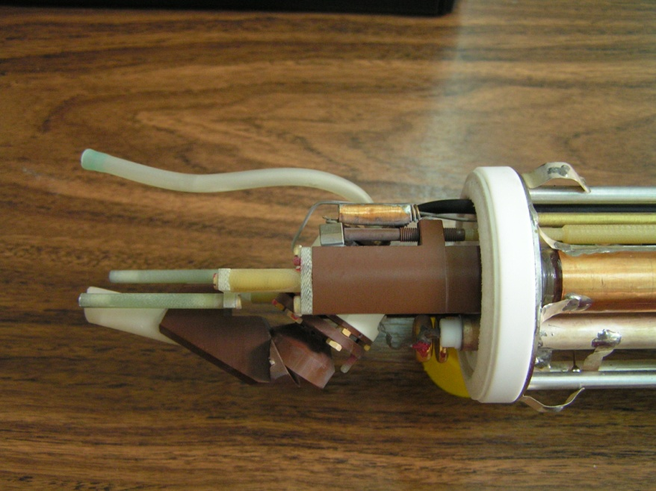
II International NMR Training Course
“INDUSTRIAL AND SOCIOECONOMIC APPLICATIONS OF SOLID-STATE NMR”
NMR spectroscopy is a powerful technique that produces structural information on short- and medium-range scales that can not be obtained by other experimental means. This introductory training course of solid-state NMR will focus mainly on materials with practical applications and potential benefits for industry and society.
October 26th - 28th 2015
Instituto de Cerámica y Vidrio (ICV-CISC) Campus Cantoblanco CSIC, Kelsen 5, 28049, Madrid (SPAIN)
October 26th
October 27th
October 28th
Jesús Sanz (ICMM-CSIC)
RMN de estado sólido en España
Randall E. Youngman (CORNING GLASS )
NMR of glasses and glass-ceramics in glass industry
Leoncio Garrido (ICTP-CSIC)
PFG-NMR: Molecular and ionic transport
in polymer membranes
María José de la Mata (Sidi-UAM)
Adquisición de espectros en RMN
Francisco Muñoz (ICV-CSIC)
NMR of phosphate glasses for electrical applications
Ernesto Brunet (UAM)
Aplicación de la RMN de sólidos a la industria farmacéutica: Principios activos (APIs)
Zhehong Gan (NHMFL)
Solid-state NMR at high fields and of difficult-to-observe nuclei
Barbara Perrone (BRUKER)
New developments in Solid State NMR
Juan Miguel López del Amo (CIC Energigune)
Bio Solid-State NMR: Applications to structural biology and drug design
Isabel Sobrados (ICMM-CSIC)
Materias primas y fritas para pavimentos y revestimientos cerámicos
Koji Yazawa (JEOL)
Go Fast: 3 Acts in Solid State NMR through the JEOL’s State of The Art
José Ignacio Santos (SGIker- UPV/EHU)
Estudio de polimorfos de principios activos mediante
la técnica de ¹³C CPMAS RMN
Ana Fernández (IETCC-CSIC)
Resonancia magnética nuclear aplicada a materiales cementantes
Juan Rubio (ICV-CSIC)
Vidrios especiales para la industria
María Dolores Alba (ICMSE-CSIC)
Ceramic hosts for immobilization of hazardous waste: Study by solid state NMR.
Teresa Blasco (ITQ-CSIC)
Algunos ejemplos de aplicación de la RMN en catálisis heterogénea
Jesús Sanz (ICMM-CSIC)
Applications of NMR in solid electrolytes
Juan Miguel López del Amo (CIC Energigune)
Solid-State NMR of paramagnetic materials
Luis Sánchez Muñoz (ICV-CSIC)
Industrial ceramic pigments
Manuel Sánchez (ICP-CSIC)
RMN de materiales nanoporosos con aplicaciones
Direction and Organization
Sponsors and collaborating institutions
Luis Sánchez-Muñoz
lsm@icv.csic.es
Francisco Muñoz
fmunoz@icv.csic.es

Slide 2
Procedure
1.- Registration fees: Students 100 €, Researchers 150 €.
Instituto de Cerámica y Vidrio (CSIC), Kelsen 5, 28049, Madrid, Spain
IBAN: ES55 0049 4099 4128 1415 0914 SWIFT: BSCHESMM
Banco de Santander, Avenida de la Zaporra 1, 28100 Alcobendas (Madrid, Spain)
2.- Fill this registration form:
3.- Send the “registration form” and “receipt of payment” to: solidstateNMR@icv.csic.es (deadline: Oct. 21th, 2015)
Participant | Billing Information
Name: | Name:
Address: | Address:
Email: | Email:
Telephone number: | NIF/VAT number:
NOTES
- The registration fees include the training course, breakfast and lunch for the three days
- Most talks will consist of a brief introduction of a particular industrial sector and then some applications of the solid-state NMR techniques.
- The training course includes 20 teaching hours
Course certificates will be prepared if demanded
Participants are limited to 140 seats
The Sociedad Española de Cerámica y Vidrio offers 15 travel grants of 100 € for its partners (secv@icv.csic.es)

