Slide 1
The Doctorate and the Doctoral School (DOKe)

Slide 2
Doctoral School, DOKe
DOKe manages and coordinates
66 doctoral programmes:
~4000 doctoral candidates/students
~25% foreign students
Student council
10 representatives

Slide 3
Doctoral School, DOKe
There are 5 areas of knowledge:
1. Sciences
2. Engineering and Architecture
3. Health Sciences
4. Social and Legal Sciences
5. Arts and Humanities

Slide 4
Doctoral School, DOKe
Leioa
Headquarters
Donostia
San Sebastián
Vitoria-Gasteiz
Araba Campus
Micaela Portilla Centre
Gipuzkoa Campus
Ignacio Maria Barriola building
Bizkaia (Leioa) Campus
Central Library building
4

Slide 5
Doctoral School, DOKe
doke@ehu.eus general
doke.heziketa@ehu.eus training
doke.hitzarmenak@ehu.eus agreements
doke.kalitatea@ehu.eus quality
doke.lantxertaketa@ehu.eus employability and social inclusion
doke.zuzendaritza@ehu.eus dean team
international.doke@ehu.eus international relations
latinoamerica.doke@ehu.eus latin american postgraduate network

Slide 6
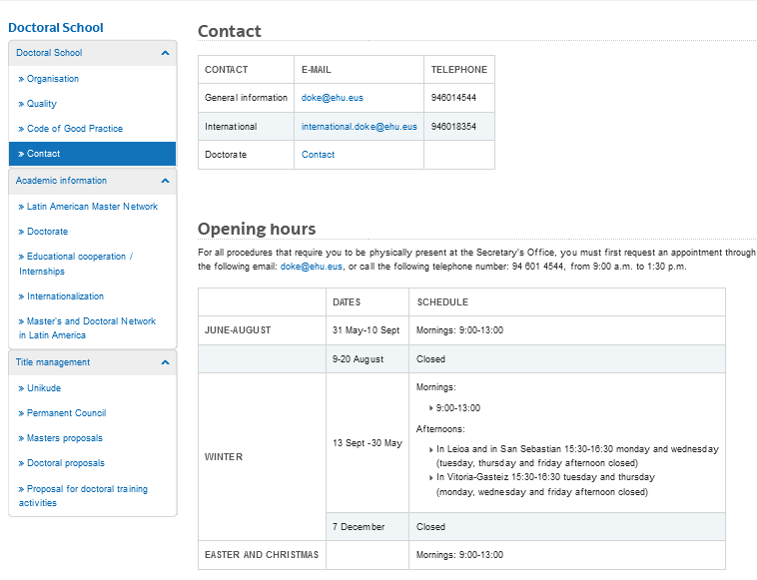
Doctoral School, DOKe
6

Slide 7
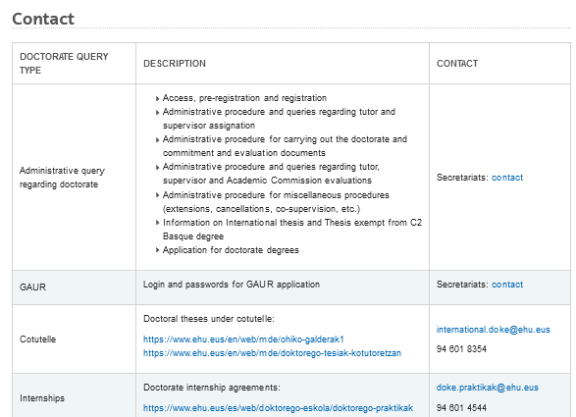
Doctoral School, DOKe
7

Slide 8
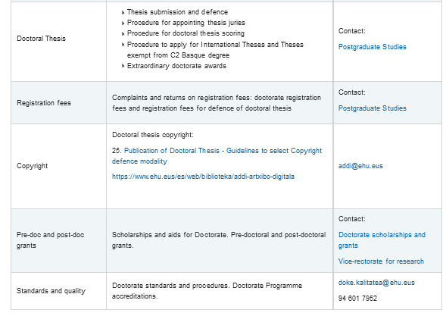
Doctoral School, DOKe
8

Slide 9
Doctoral School, DOKe

Slide 10
The UPV/EHU doctorate: characteristics
66 UPV/EHU doctoral programmes
Regulated by:
R.D. 99/2011 (BOE, Spanish regulations)
Regulations Governing the Management of Doctoral Studies (UPV/EHU)
Regulations for the Permanence of Doctoral Students (in Basque and Spanish only, UPV/EHU)
Regulations of the DOKe

Slide 11
The UPV/EHU doctorate: characteristics
doctoral student
academic committee
coordinator
tutor
supervisor
1
2
Changes of tutor and supervisors are permitted if the request is justified.

Slide 12
The UPV/EHU doctorate: characteristics
administrative assistant DOKe administrative office
DOKe

Slide 13
The UPV/EHU doctorate: characteristics
Name of the doctoral programme
Name of the doctoral programme
Descriptive text
@ of the coordinator
@ of the secretary

Slide 14
The UPV/EHU doctorate: characteristics
Academic committee
defines, updates and coordinates the doctoral programme.
proposes modifications to the doctoral programme, in terms of teaching staff, available places, admission criteria and other matters.
decides on the admission of each candidate and defines the conditions of admission.
carries out the annual monitoring and assessment of students enrolled in the doctoral programme.
organises specific doctoral training activities
authorises the presentation and defence of the doctoral theses

Slide 15
The UPV/EHU doctorate: characteristics
Academic staff of the doctoral programmes
Tutors
They provide academic support during the doctoral studies, and ensure interaction of the doctoral students with the academic committee
Supervisors
They are responsible for the coherence and suitability of the doctoral student's training and for the impact and novelty of the thesis research

Slide 16
The UPV/EHU doctorate: development and assessment
DEDICATION and DURATION
FULL-TIME DEDICATION:
3+1+1 years
PART-TIME DEDICATION:
5+2+1 years
DISRUPTION OF THE DOCTORAL STUDIES
TEMPORARY LEAVE: 1+1 years
WITHDRAWAL FROM THE DOCTORAL STUDIES
PERMANENT LEAVE

Slide 17
The UPV/EHU doctorate: development and assessment
Common procedures
change from full-time to part-time or vice versa request for temporary leave request for permanent withdrawal request for extra time request for changing supervisors
DOKe

Slide 18
The UPV/EHU doctorate: development and assessment
Employee
Doctoral student on sick leave
Student
Temporary leave in the doctoral programme
Sick leave, staff office
DOKe

Slide 19
The UPV/EHU doctorate: development and assessment
Statement of commitment
research plan
objectives to be achieved
methodology to be used
means and timetable for the research
doctoral training activities
ACTIVITY DocumenT
supporting documents for the training activities

Slide 20
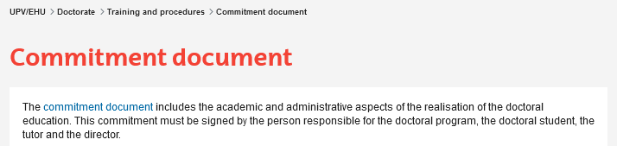
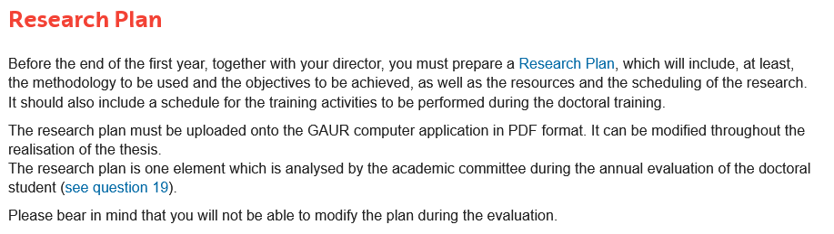

Slide 21
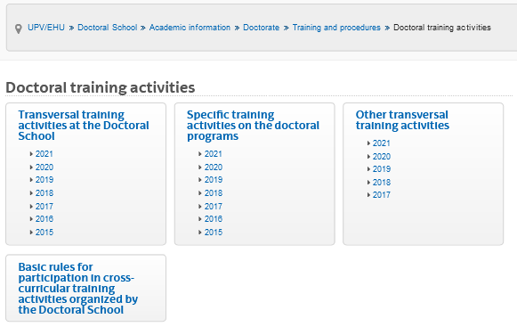
The UPV/EHU doctorate: development and assessment

Slide 22
The UPV/EHU doctorate: development and assessment
Signing of the statement of commitment
Statement of commitment
Design and implementation of the RP
Report on the RP and the DA
RP
DA
Report
Assessment of the RP and the DA
PI
DA
Ordinary call
Positive assessment
Enrolment and payment for 2nd and successive academic years
PS
End of the thesis:
Presentation and defence
Positive assessment
RP: Research plan
DA: Activity document
PS: Postgraduate Service

Slide 23
The UPV/EHU doctorate: development and assessment
Signing of the statement of commitment
Statement of commitment
Design and implementation of the RP
Report on the RP and the DA
RP
DA
Report
Assessment of the RP and the DA
X
Ordinary call
Negative assessment
PI
DA
Enrolment and payment for 2nd and successive academic years
X
PI
DA
Extraordinary call
Positive assessment
PS
End of the thesis:
Presentation and defence
Negative assessment followed by
Positive assessment
RP: Research plan
DA: Activity document
PS: Postgraduate Service

Slide 24
The UPV/EHU doctorate: development and assessment
Signing of the statement of commitment
Statement of commitment
Design and implementation of the RP
Report on the RP and the DA
RP
DA
Report
Assessment of the RP and the DA
X
Ordinary call
Negative assessment
PI
DA
Enrolment and payment for 2nd and successive academic years
X
X
PI
DA
Extraordinary call
Negative assessment
permanent withdrawal
Negative assessment followed by
negative assessment
RP: Research plan
DA: Activity document
PS: Postgraduate Service

Slide 25
The UPV/EHU doctorate: development and assessment
Voluntary permanent withdrawal
DOKe

Slide 26
The UPV/EHU doctorate: development and assessment
Mentions of the doctoral theses
“International Doctorate” mention (RD 99/2011)
International mobility, 3 months at least
“Industrial Doctorate” mention (RD 99/2011)
Employment contract, 1 year at least
Thesis in collaboration with external entities (UPV/EHU)
Collaboration project with the external entity

Slide 27
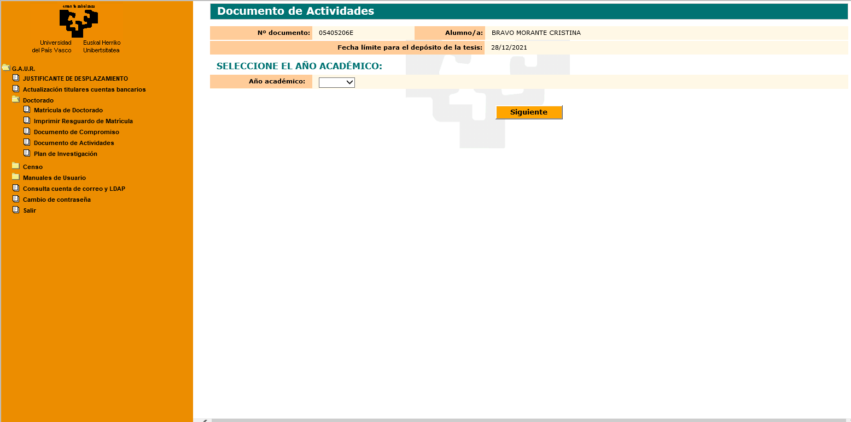
GAUR: IT platform
Access via LDAP protocol
Apple devices, MAC devices, tablets and CHROME browser not recommendable

Slide 28
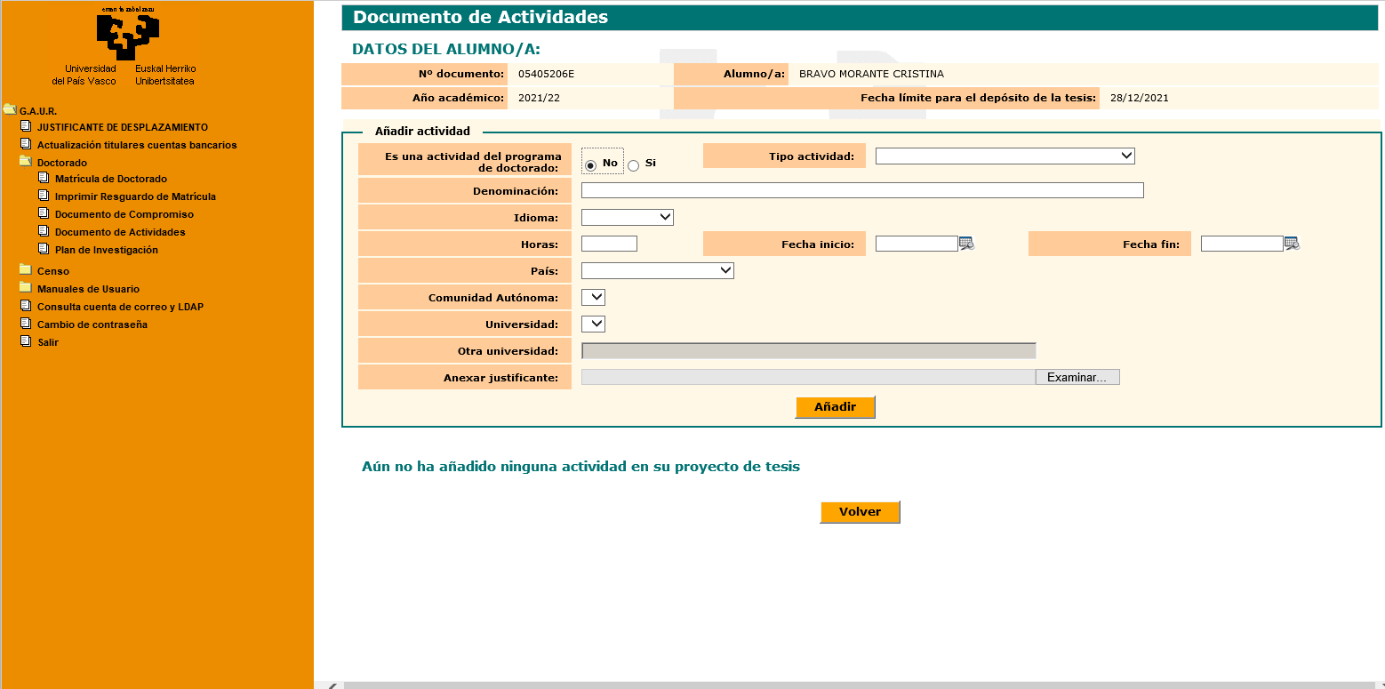
GAUR: IT platform

Slide 29
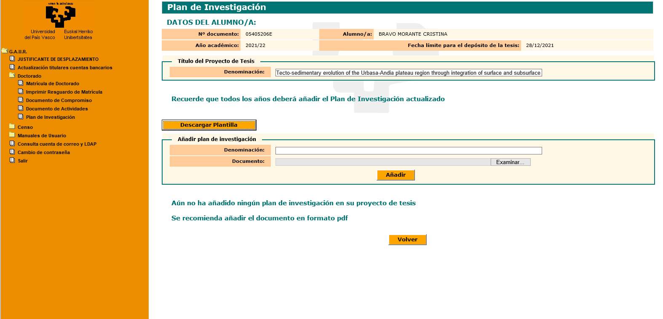
GAUR: IT platform

Slide 30
GAUR: IT platform

Slide 31
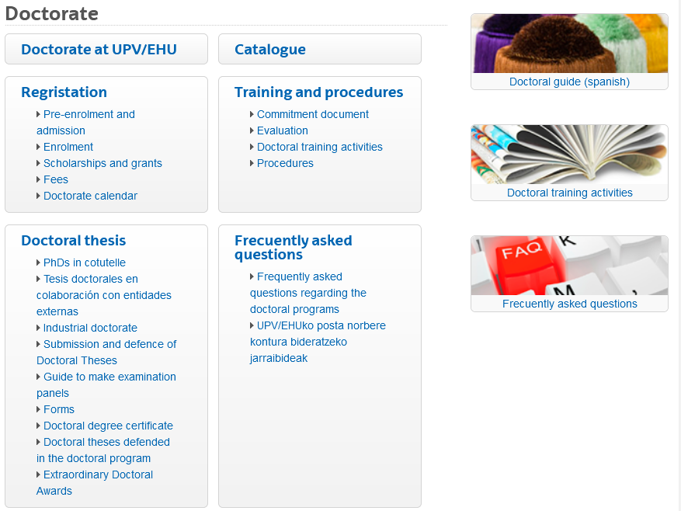
Information and procedures
Postgraduate service

Slide 32
Information and procedures
Redirect corporate email to another email address
delete and purge
ifamilynameXXX@ikasle.ehu.eus

Slide 33
Information and procedures
DOKe
Administrative enquiries and procedures at the doctoral administrative office: Administrative Contact
General information about the doctoral programmes
Access, pre-registration and enrolment
Administrative procedures:
Assignment of tutors and supervisors
Development of the doctoral programmes
Doctoral evaluations
Changes of full-time/part-time dedication, supervisors and tutors
Inclusion of co-supervisors
Temporary and permanent withdrawals and extensions

Slide 34
Information and procedures
Other queries:
Access and passwords to GAUR
doke@ehu.eus
Cross-cutting training activities
doke.heziketa@ehu.eus
Joint doctoral theses and mobilities: international.doke@ehu.eus

Slide 35
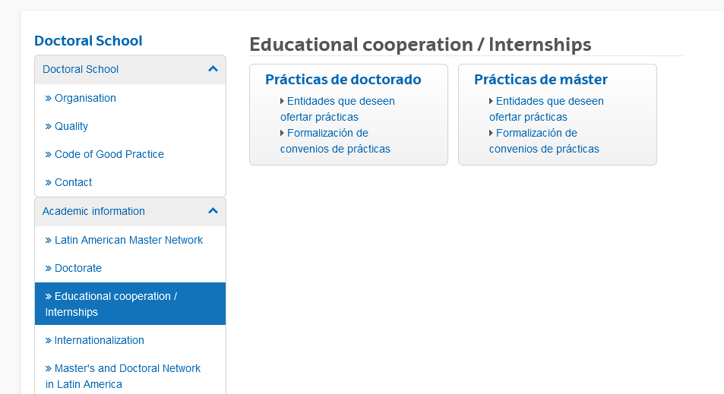
Educational cooperation
Internships
doke.praktikak@ehu.eus

Slide 36
Educational cooperation
Internships

Slide 37
Internationalisation and mobility
international.doke@ehu.eus
Student enrolled at a foreign institution
Student enrolled at the UPV/EHU
Doctoral School
DOKe
Cotutelle Agreement
Wants to do a doctoral thesis under cotutelle
Wants to do a doctoral thesis under cotutelle
Activates
cotutelle process
Programming and development of doctoral training
PhD student enrolled at the UPV/EHU and the foreign University
Wants to do a postgraduate mobility at the UPV/EHU
Wants to do a postgraduate mobility at a foreign institution
Certificate of stay
Activates process: Erasmus mobility
Other stays
ToR or stay report
Learning Agreement

Slide 38
Internationalisation and mobility
 | International thesis | Thesis in cotutelle
Minimum stay | 3 months at a university abroad | 9 months at each university
Enrolment
Titles
Agreement | no | yes
Doctoral programmes | 1 | 2

Slide 39
Internationalisation and mobility
Thesis in cotutelle
Application in the first academic year; exceptionally, in the second year
Enrolment at both universities every academic year
Joint supervision agreement negotiated and signed by both institutions

Slide 40
Internationalisation and mobility
Erasmus + Doctorate
Language requirement (B1/B2)
Funding
Country group | Country | Monthly amount | Supplement*
1 | Denmark, Finland, Iceland, Ireland, Liechtenstein, Luxembourg, Norway, Sweden, UK | 310 | 250
2 | Germany, Austria, Belgium, Cyprus, France, Greece, Italy, Malta, Netherlands, Portugal | 260
3 | Bulgaria, Croatia, Czech Republic, Estonia, Hungary, Latvia, Lithuania, Northern Macedonia, Poland, Romania, Serbia, Slovakia, Slovenia and Turkey | 210
*Supplement for students with fewer opportunities
The doctoral student has to find a SUPERVISOR
More information: ORI (International Relations Office, UPV/EHU)

Slide 41
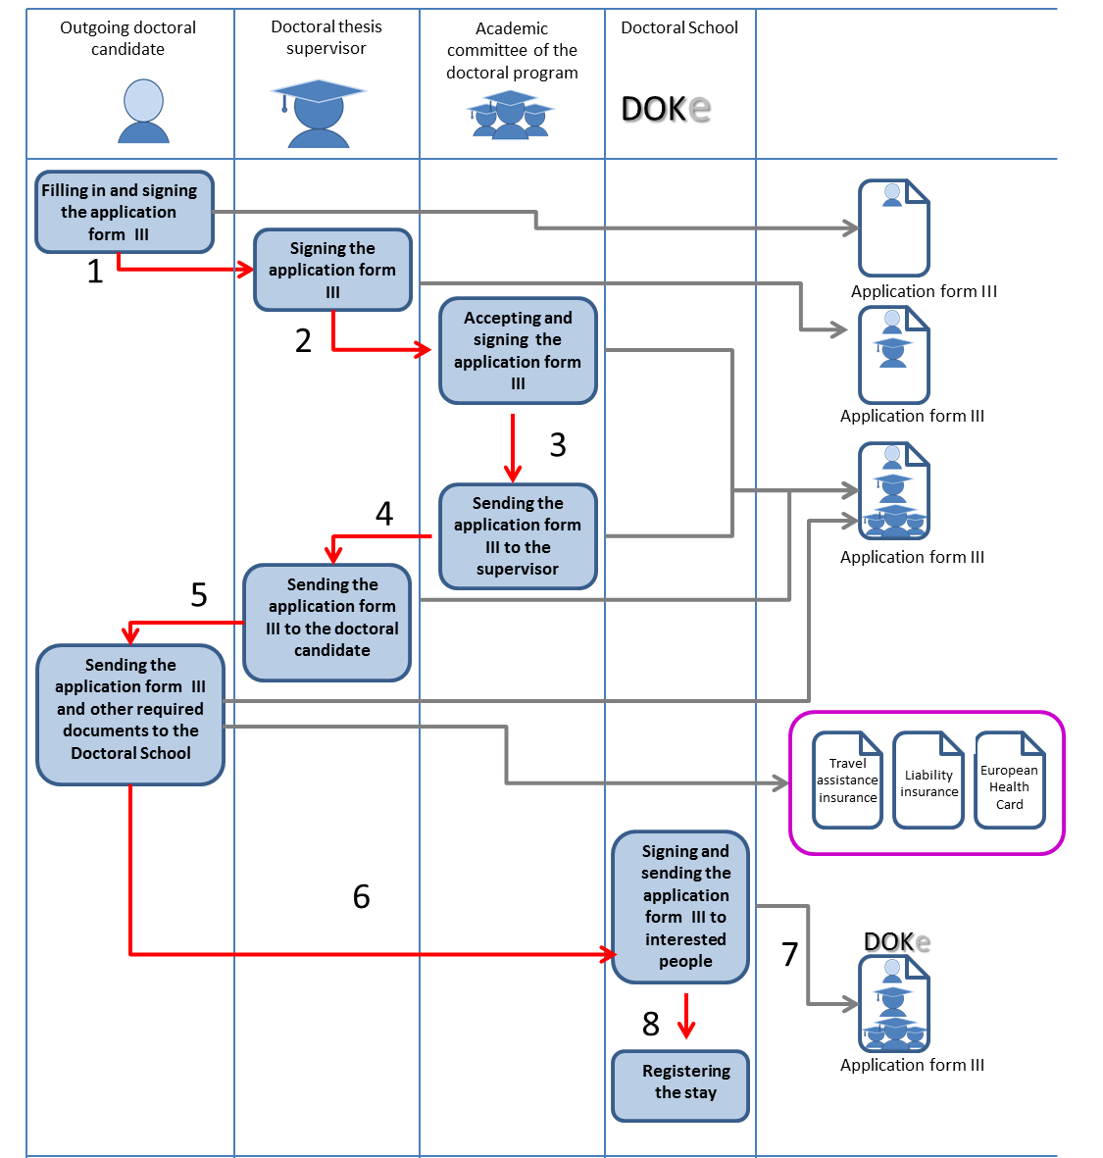
Internationalisation and mobility
Other research stays

Slide 42
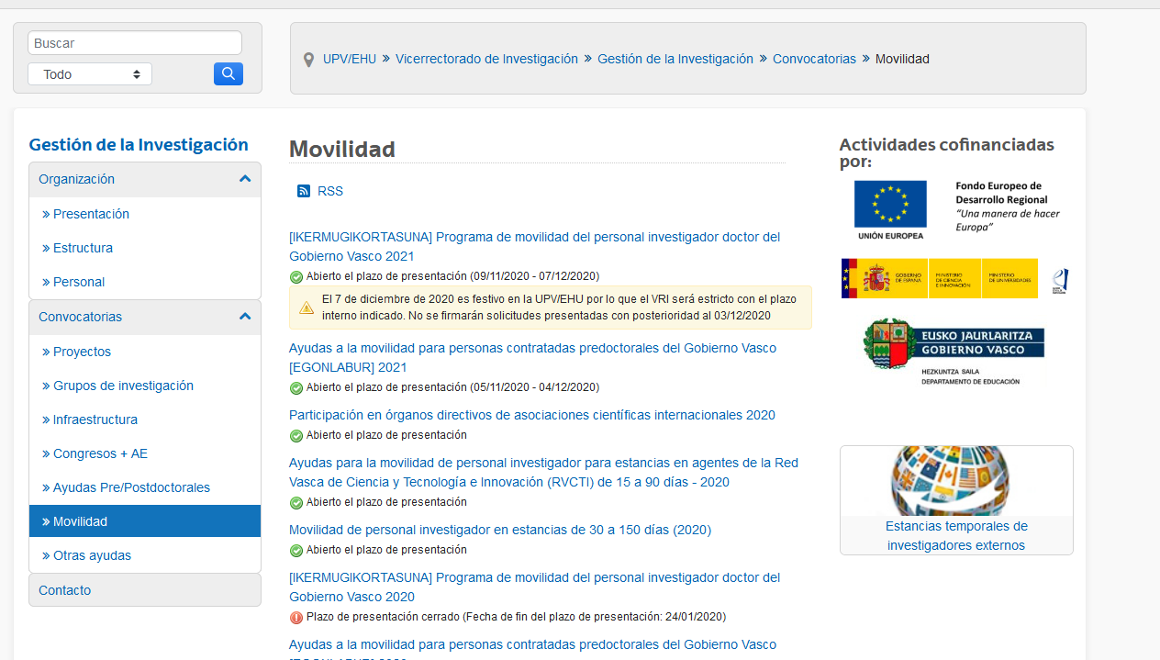
Internationalisation and mobility

Slide 43
Regulations and good practice
DOKe

Slide 44
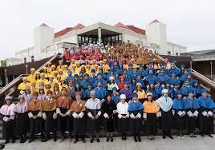
Thank you very much for your attention
www.ehu.eus/es/web/doktorego-eskola/home

